Slide 1
Fluid Dynamics
Hashem Alayed
Mohannad Aldughaim
Sean Boocock

Slide 2
Overview
Implemented a model for fluid flow found in Dynamic Simulation of Splashing Fluids
Simulated the fall and surface interaction of objects with the fluid volume
Created an extensible rain simulation that interacted with the fluid volume
Wrote simulation in C++ and Python; rendered in Maya
Notes:
Dynamic Simulation of Splashing Fluids appeared in Computer Animations 1995
Motivation for this algorithm/approach is that it is a fairly accurate approximation that produces good results as we have shown at significant speed improvements over more accurate simulations like 3DNavier-Stokes equations

Slide 3
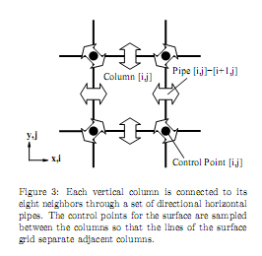
Fluid Volume
Simulation of fluid volume based on a series of columns connected by “virtual” pipes
Flow is calculated between the columns based on differences in height, external pressure and subject to conservation constraints
Notes:
Note that the fluid volume algorithm is O(t*width*height) vs O(t*n^3) for more detailed simulations like Navier-Stokes equations.

Slide 4
Fluid Volume
Flow was calculated at every time step in the simulation with the edges as boundaries of zero flow
Simulation used accurate physical constants for the fluid density of water, atmospheric pressure, gravitational acceleration
Evolution of the fluid volume highly sensitive to the length/area of the virtual pipes (.008 and .002 meters were found to be best for a 30x30 meter pool of water)
Notes:
Note that the fluid volume algorithm is O(t*width*height)

Slide 5
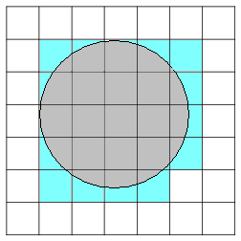
Falling Object
Simulated the impact of a falling sphere on the column of grids making up the fluid volume
Implemented basic collision detection and pressure calculations for different grid sizes relative to sphere sizes
Notes:
Using conservation of energy and modeling the impact as having a definite stopping distance past the surface at which the object would stop.
Calculated pressure by calculating the percentage overlap of each square of the grid with the projection of the falling sphere

Slide 6
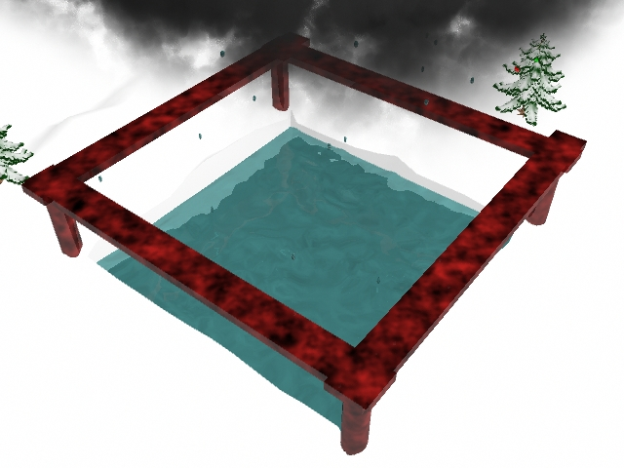
Simulating Rain
Created scalable rain system that accurately models the deformation and spawning of rain droplets as they fall from a cloud in our scenes
Collision detection handled on a per droplet basis with column volumes adjusted for droplet addition
Notes:
Dynamic scaling of droplets as they fall along the y-axis to account for wind shear.
Ability to set time stops for ramp up/ramp down of rain, rain start and rain end.
Ability to easily scale the number of simultaneous droplets from 1 to n.

Slide 7
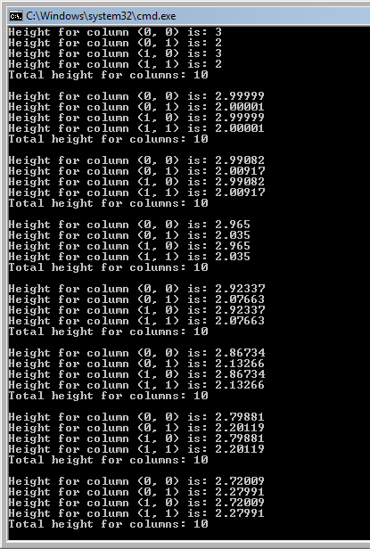
Implementation
First implemented the fluid volume simulation in C++
C++ provided a quick way to prototype changes to the simulation, effects of different physical constants, and a reality check on conservation constraints
Future systems, rain and falling objects, were written in Python along with a port of the fluid volume simulation

Slide 8
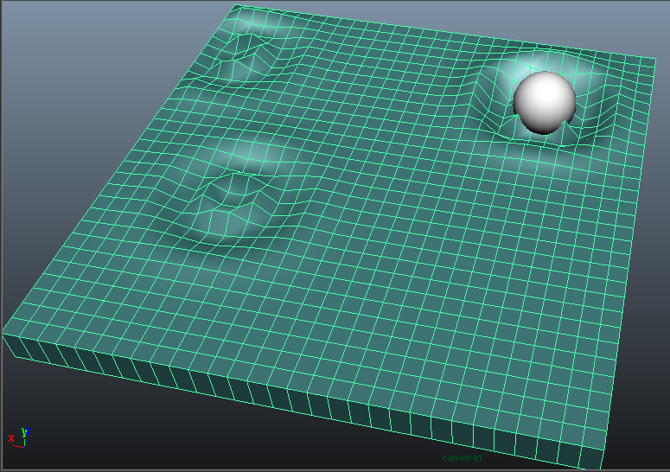
Implementation
Final implementation in Python and rendered in Maya using Maya Software renderer and hypershade
Implemented the column grid fluid volume as a Maya polycube
Created a season appropriate scene to showcase the subtleties of the simulation

Slide 9
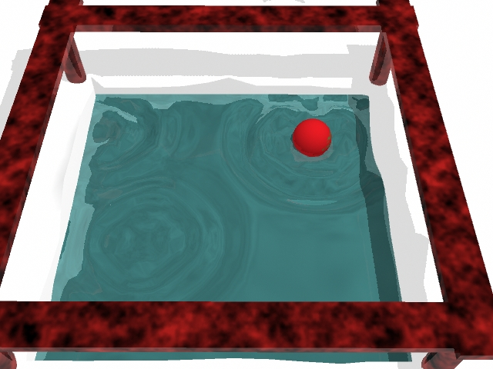
Videos
Notes:
Rain simulation (long version with complex scene): http://www.youtube.com/watch?v=pndcBEf_S74
Falling object: http://www.youtube.com/watch?v=6XrGp6tdj10
Rain simulation( 50x50 grid; sublte waves): http://www.youtube.com/watch?v=_RZq8UX57r0

Slide 10
Q/A
Thank you for your time

